Slide 1
Chemical Composition of Fibers

Slide 2
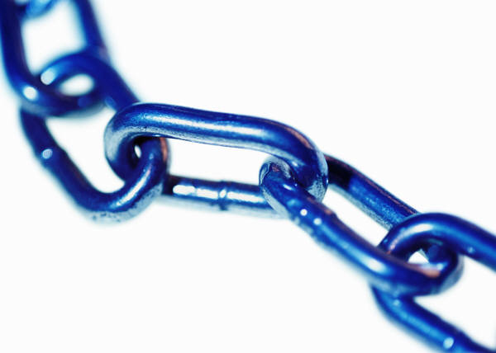
Chemical Composition of Fibers
→Fibers are polymers:
long chains made of simple molecules

Slide 3
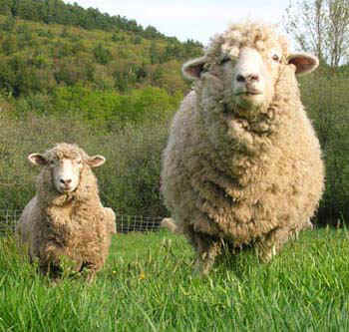
Natural Fibers
Wool
Polymer= Polypeptide chains (forming the protein keratin)
Monomer= amino acids (one of which is cysteine . . .cysteine contains Sulfur)
http://www.leydenglenlamb.com/photos.htm

Slide 4
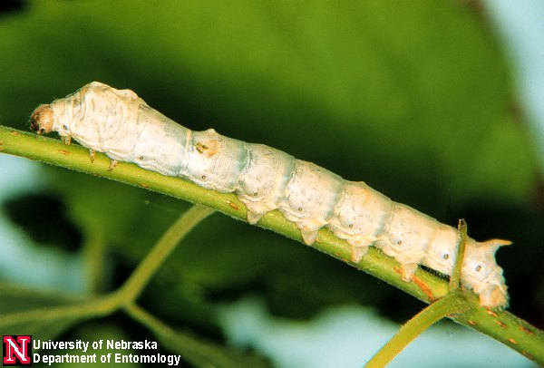
Natural Fibers
Wool
Polymer= Polypeptide chains (forming the protein keratin)
Monomer= amino acids (one of which is cysteine . . .cysteine contains Sulfur)
Silk
Polymer= protein
Monomer= amino acids (but less of a variety than wool)
http://entomology.unl.edu/images/silkworm/silkworm1.jpg

Slide 5
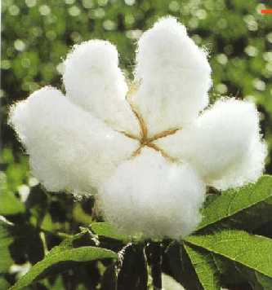
Natural Fibers
Wool
Polymer= Polypeptide chains (forming the protein keratin)
Monomer= amino acids (one of which is cysteine . . .cysteine contains Sulfur)
Silk
Polymer= protein
Monomer= amino acids (but less of a variety than wool)
Cotton
Polymer= cellulose (plant)
Monomer= glucose
http://www.texaspolicecentral.com/Texas-Patriotism.php

Slide 6
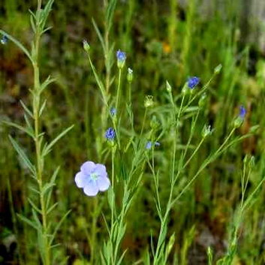
Natural Fibers
Wool
Polymer= Polypeptide chains (forming the protein keratin)
Monomer= amino acids (one of which is cysteine . . .cysteine contains Sulfur)
Silk
Polymer= protein
Monomer= amino acids (but less of a variety than wool)
Cotton
Polymer= cellulose (plant)
Monomer= glucose
Linen
Polymer= cellulose (flax plant)
Longer chains than cotton which makes it brittle
Monomer= glucose
http://www.flowers-cs.com/flax.html

Slide 7
Man-made Fibers
Rayon
Cellulose fiber, then chemically altered, burns like cotton
Acetate
Made from a reaction between cellulose and acetic acid

Slide 8
Synthetic Fibers: Generic classification of synthetic fibers
Polyamides
—linked by amino group
Example: Nylon
Stronger and more chemically inert than natural fibers
Image from: http://www.imageenvision.com/collection/fitness.html

Slide 9
Synthetic Fibers: Generic classification of synthetic fibers
Polyamides—linked by amino group
Example: Nylon
Stronger and more chemically inert than natural fibers
Polyesters
—linked by ester group
Stronger linkage than polyamides
Linkage can be linear (flexible) or cross-linked (rigid)
Image from: http://www.imageenvision.com/collection/fitness.html

Slide 10
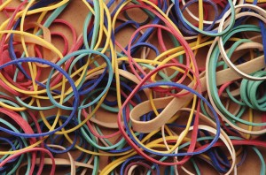
Synthetic Fibers: Generic classification of synthetic fibers
Polyamides—linked by amino group
Example: Nylon
Stronger and more chemically inert than natural fibers
Polyesters—lined by ester group
Stronger linkage than polyamides
Linkage can be linear (flexible) or cross-linked (rigid )
Spandex—structurally similar to polyamide
Made of segments of polyurethane connected to long segments of polyesters
Resulting spandex can stretch up to 600 times and recover original strength
http://www.fingerpainrelief.com/rubber-band-therapy-for-finger-pain/

Slide 11
Video clips on slide two —click on the two pictures within the chain
Clip 1
http://www.youtube.com/watch?v=cmlunCbBV_o&feature=related
If link is broken, go to YouTube and search “Oil Absorbing Polymer”
Clip 2
http://www.youtube.com/watch?v=YWoQ3D6RMXs&feature=related
If link is broken, go to YouTube and search “Spangler's Polymer Experiment on The Ellen Show”

